Slide 1
Wind Energy Story
File created on: 1/28/2021 12:22:46

Slide 2
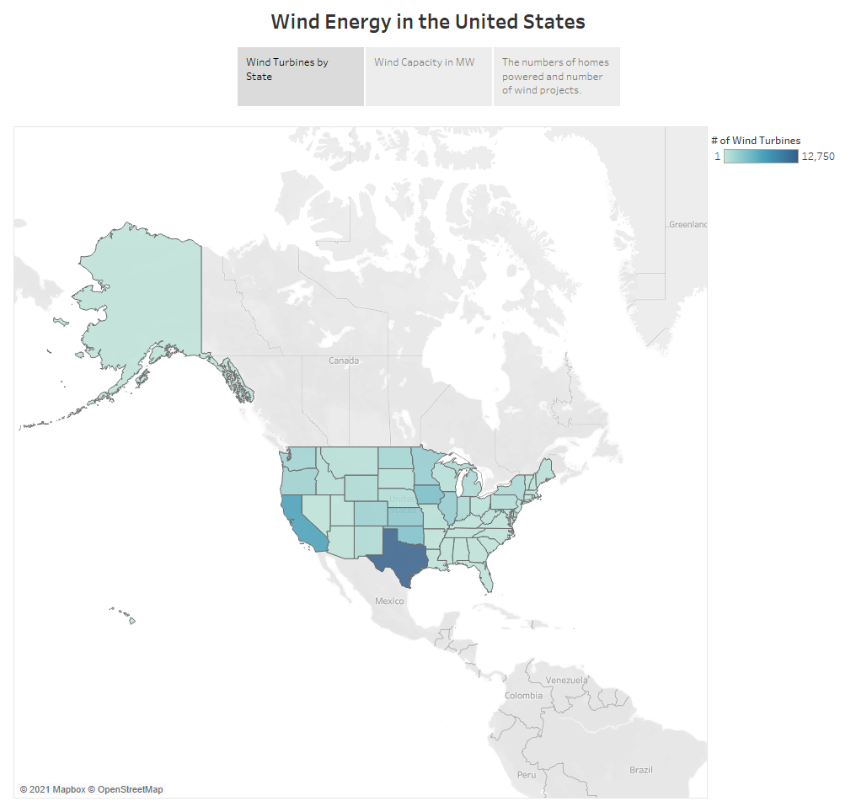

Slide 3
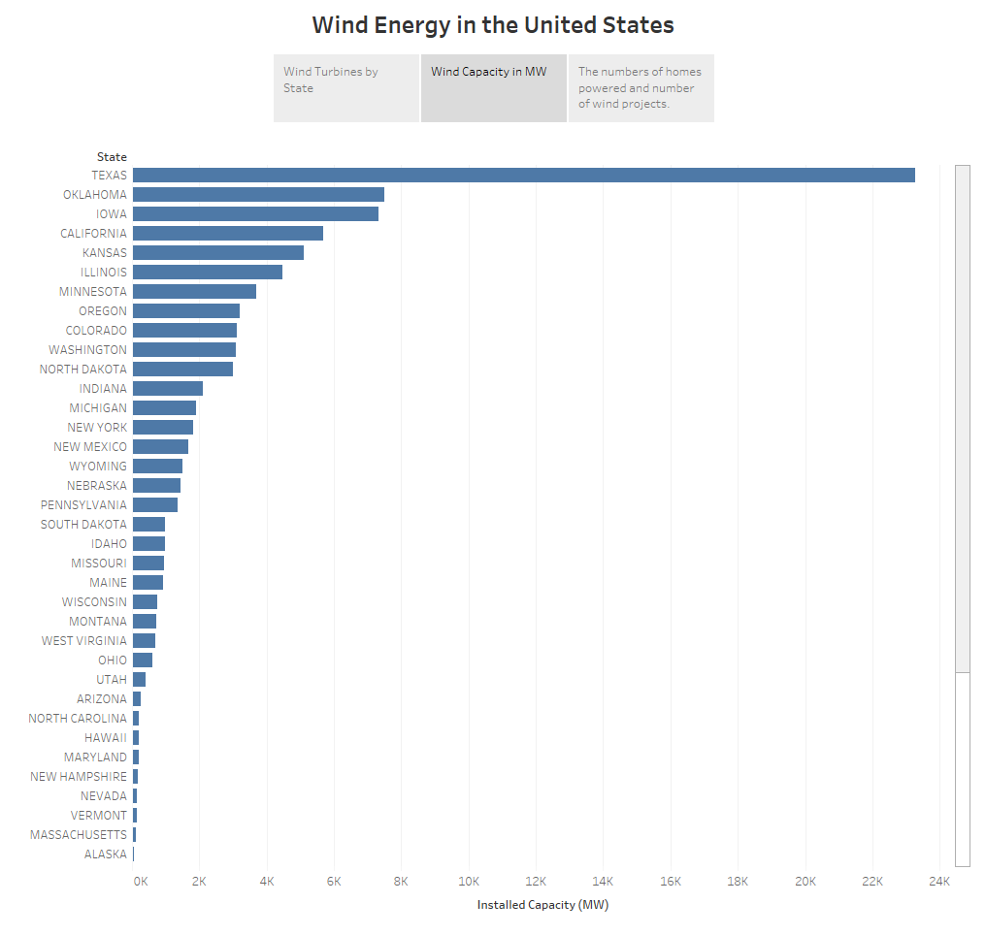

Slide 4
